Slide 1
Used Car price prediction
Hetansh Patel

Slide 2
ABOUT Data
The dataset contains 3,000,040 rows.
Target field: Price
Number of attributes: 66 - These are the demographics and other features to describe a car
We can explore the possibility in predicting price based on the individual car information.

Slide 3
Data collection
Data Website: https://www.kaggle.com/datasets/wenruliu/adult-income-dataset/data

Slide 4
Problem Statement

Slide 5
Problem Statement
The main problem in this data set is most of the features are in character types.

Slide 6
Pre-Processing

Slide 7
Handling NA values
There were NA values in columns
Most of them are Character type. So we can’t just apply random values inside them. Its better to delete the entire rows rather than giving misleading information.

Slide 8
Dropping columns for analysis
Dropped columns which showed similar properties of a car or has no effect on price just by looking at them.

Slide 9
Data Exploration

Slide 10
Reviewing each feature
Body_type (object)
city_fuel_economy (float)
Engine_displacement (float)
Engine_type (object)
fleet (object)
Frame_damaged (object)
Franchise_dealer (bool)
Fuel_tank_volume(object)
Fuel_type (object)
Has_accidents (object)
Highway_fuel_economy (float)
Horsepower (float)
isCab (object)
Listing_color (object)
Make_name (object)
Maximum_seating (object)
mileage (float)
Owner_count (float)
torque (object)
Transmission_display (object)
Wheel_system (object)
year (int)
price (Target Variable) (float)

Slide 11
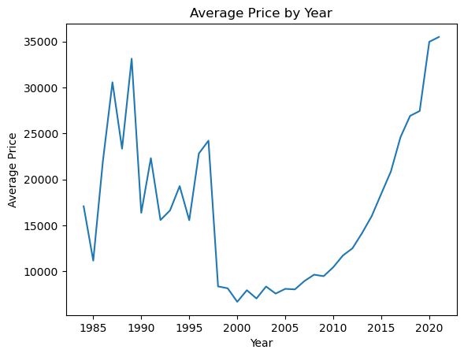
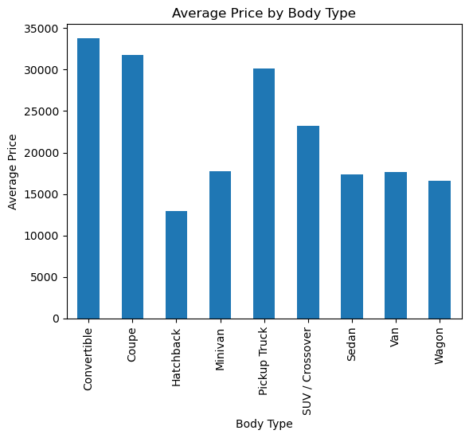
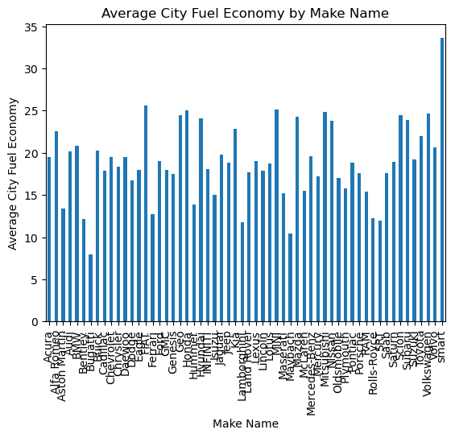
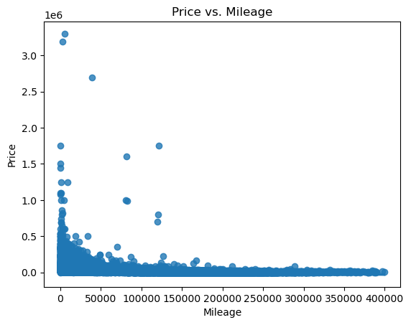
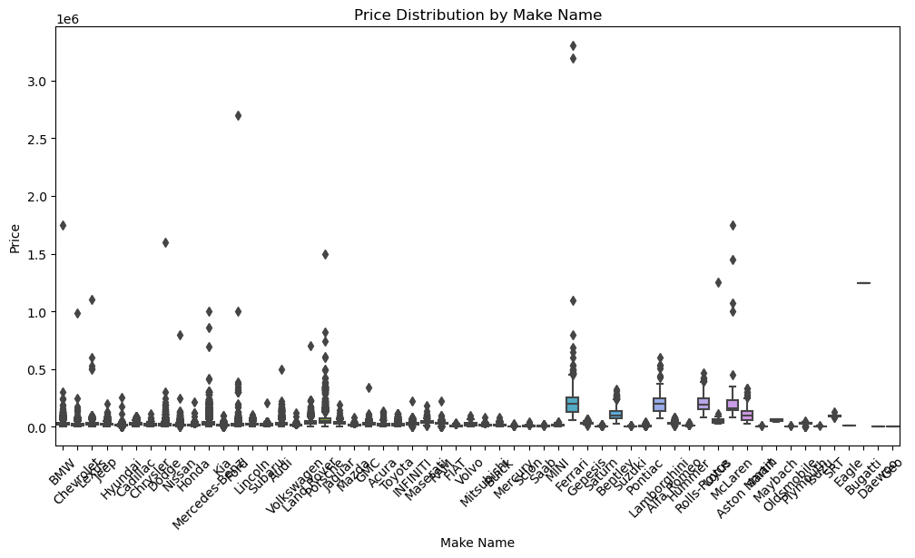
Overview of data

Slide 12
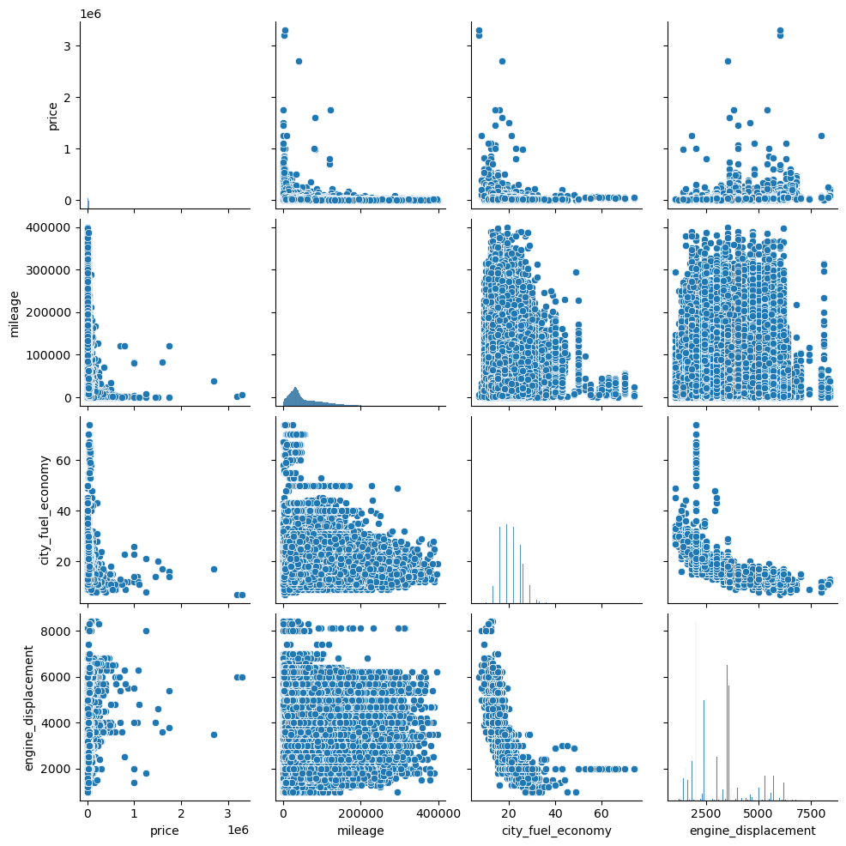
Overview of data

Slide 13
Data Transformation

Slide 14
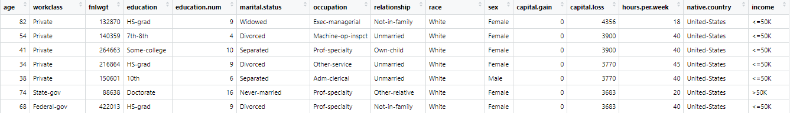
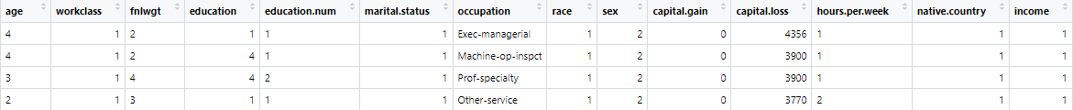
Giving categories
Transforming character data into categorical variables. This transformation will make our data set more compatible with more statistical techniques. Categorizing each character column to numerical codes, simplifying data while retaining its essential information. This process enhances our dataset’s suitability for statistical analysis, setting the stage for deeper exploration and insights.

Slide 15
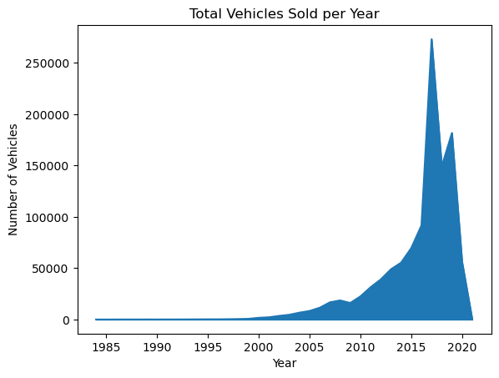
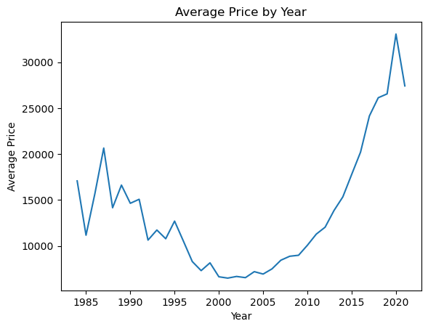
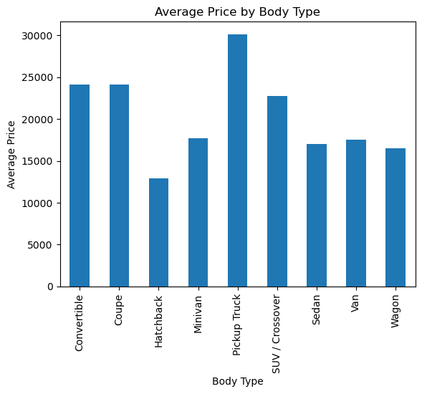
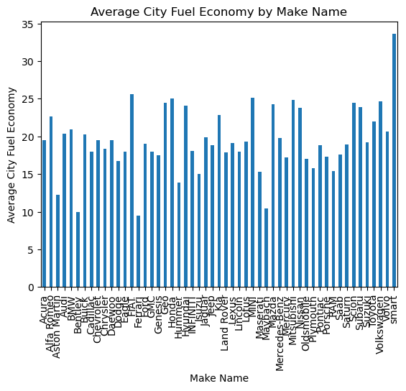
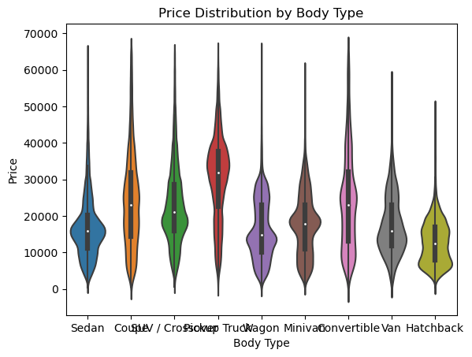
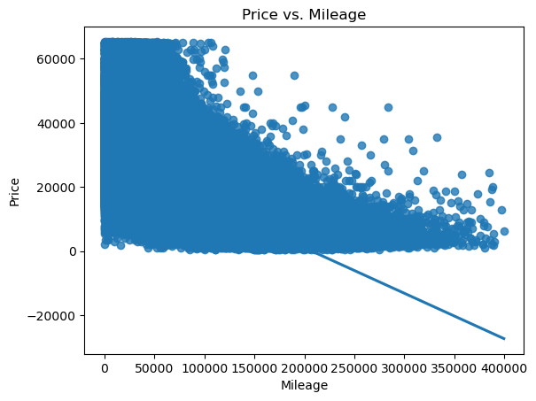
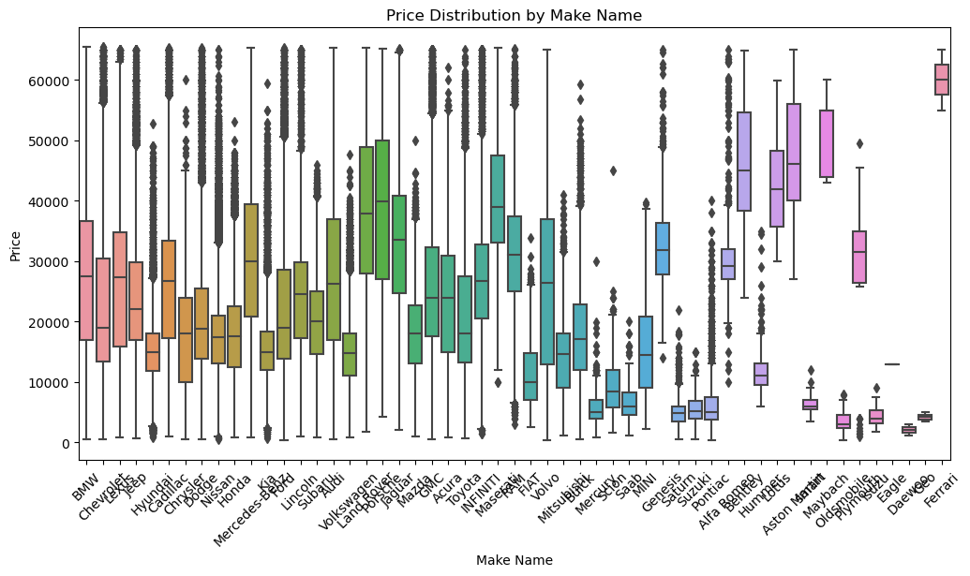
Overview of data

Slide 16
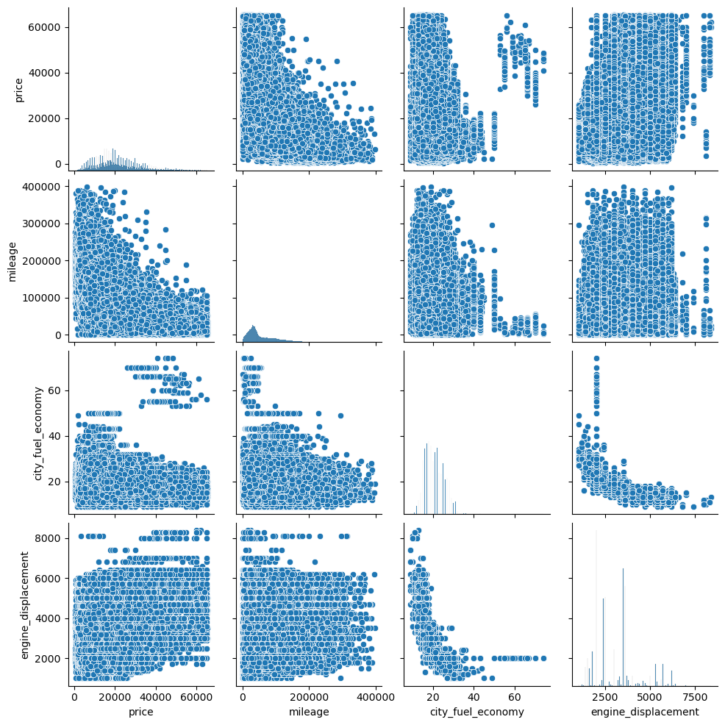

Slide 17
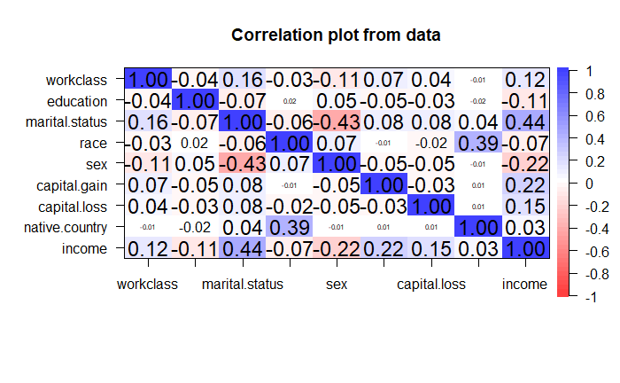
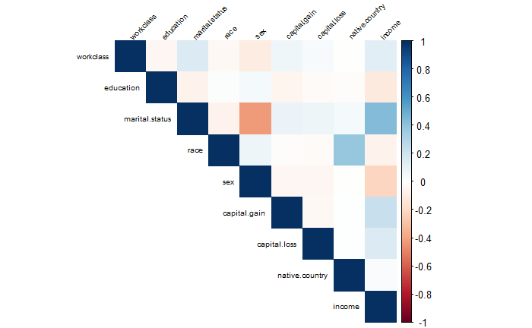
Correlating data
Objective of this was to discern which features within the dataset held the most relevance and which ones were less informative. This process allows us to gain insights into the interrelationships between different variables. It is important to eliminate less influential features to reduce dimensionality and enhancing the efficiency of our analysis. This approach to data reduction ensures to focus more on critical aspects of data.

Slide 18
Problem Statement
Binary Classification
Targeting Services
The dataset contains demographic and socioeconomic attributes, and the main problem is to build a predictive model that classifies individuals into two income groups based on a threshold income level
The primary goal is to assist in resource allocation and financial planning by accurately identifying individuals at risk of low income, enabling targeted services and interventions.

Slide 19
Methodology

Slide 20
Algorithms
Decision Trees
Random Forest
Support Vector Machines
Naïve Bayes
Logistics Regression
XGB Tree
KNN

Slide 21
Results

Slide 23
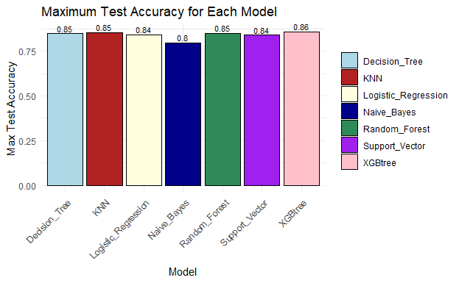
Test accuracy for updated data
Bar Chart

Slide 24
Sample result Dataset
Dataset_Number | Model | Train_Accuracy | Test_Accuracy
1 | Decision_Tree | 0.839 | 0.836
2 | Decision_Tree | 0.839 | 0.835
1 | Random_Forest | 0.841 | 0.832
2 | Random_Forest | 0.841 | 0.828
1 | Support_Vector | 0.811 | 0.810
2 | Support_Vector | 0.811 | 0.812
1 | Naïve_Bayes | 0.780 | 0.782
2 | Naïve_Bayes | 0.782 | 0.785
1 | Logistic_Regression | 0.817 | 0.821
2 | Logistic_Regression | 0.819 | 0.817

Slide 25
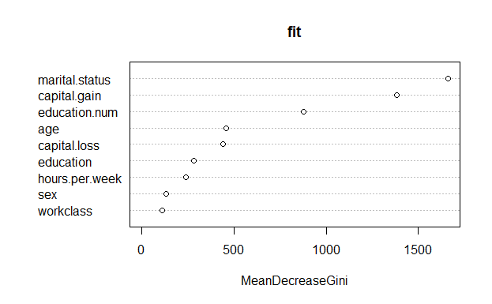
Importance of features

Slide 26
Importance of Features
From this trail and error method we know most important features of datasets. They are:
Age
Work Class
Education
Education.num
Marital status
Gender
Capital Gain
Capital Loss
Hours per Week

Slide 27
Use Cases
Credit scoring
Financial institutions can use the analysis to assess an individual's creditworthiness. By considering income, employment, and other factors, they can make informed decisions on lending and setting interest rates.
Marketing
Companies can target their marketing efforts more effectively by understanding the income and demographic profiles of their customers. This can lead to personalized advertising and product recommendations.
Government policy
Governments and policymakers can use the analysis to design and evaluate social programs, tax policies, and measures aimed at reducing income inequality or improving economic conditions for specific demographic groups.
Education planning
Educational institutions can use the information to create targeted scholarship programs, improve educational outcomes, and provide resources to students from underprivileged backgrounds.

Slide 28
THANK YOU
Any Questions?

